Slide 1
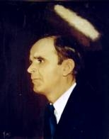

115
ISN’T HE WONDERFUL!
Isn’t He wonderful, wonderful, wonderful?
Isn’t Jesus my Lord wonderful?
Eyes have seen, ears have heard, what’s recorded in God’s Word;
Isn’t Jesus my Lord wonderful?

